Slide 1
w2-pandas-project
Lucia Gabriela Correa

Slide 2
Task - Shark attacks Dataset
Data input
Cleaning
Metrics
Dashboard
Conclusions

Slide 3
Data cleaning & wrangling
1) File dowloaded from the website 'https://www.kaggle.com/teajay/global-shark-attacks’
2) Import Pandas libraries.
Preparing the data:
READ CSV (pd.read("document.csv"))
EXPLORE DATA (df.describe(),df.shape,df.info(),df.head(),df.columns)
CHANGE DATATYPE FROM OBJECT TO:
datetime,
interger,
string.
CLEN DUPLICATES : drop.duplicates
DROPNA
FILLNA : REPLACE NaN and NaT for NONE
EXPORT CSV(df.to_csv('df.csv'))

Slide 4
Metrics
Number of attacks per type.
Number of attacks per country
Number of attacks per year.

Slide 5
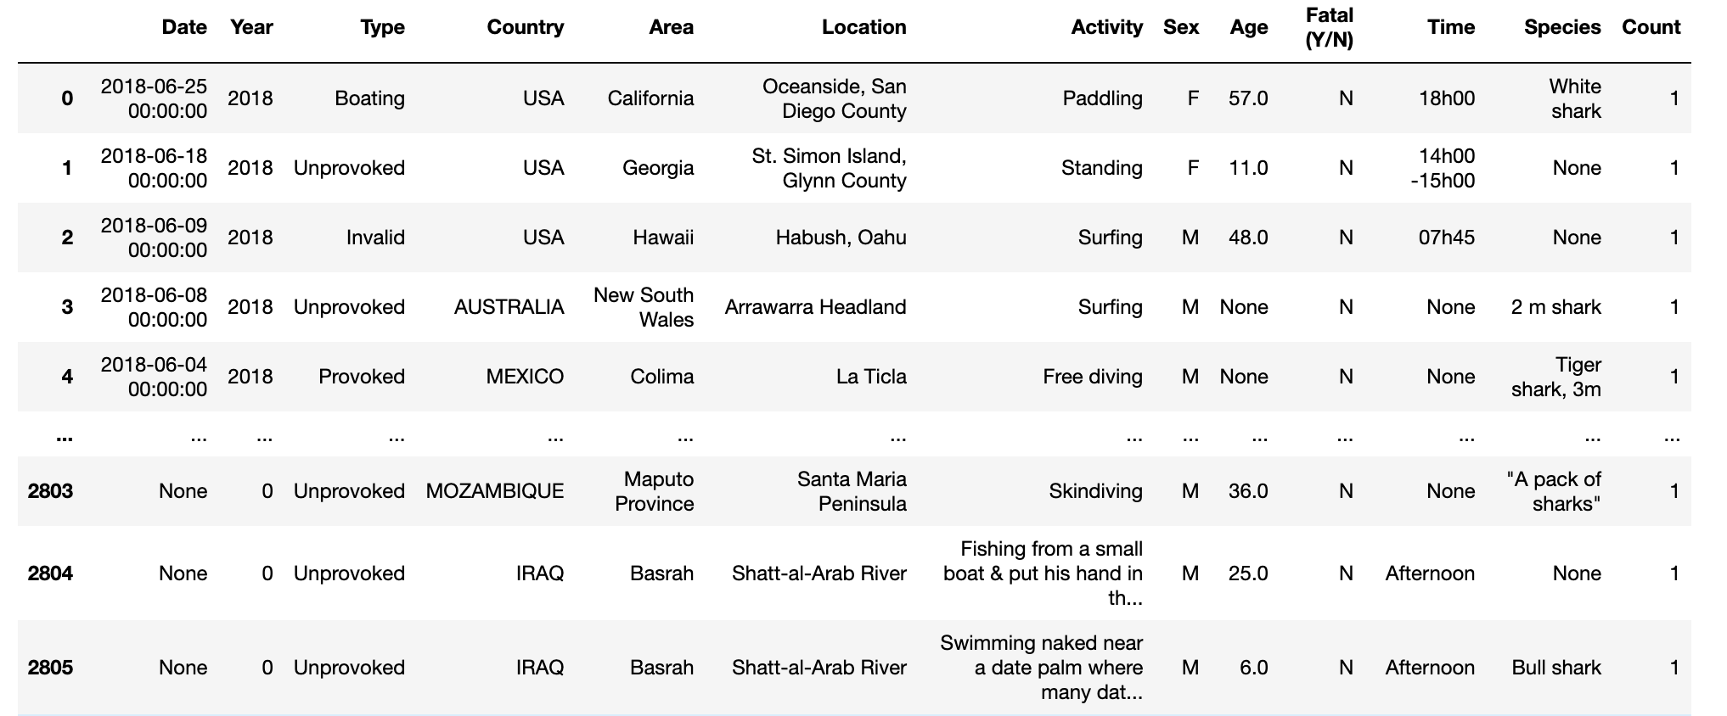
Dataset after cleaning…

Slide 6
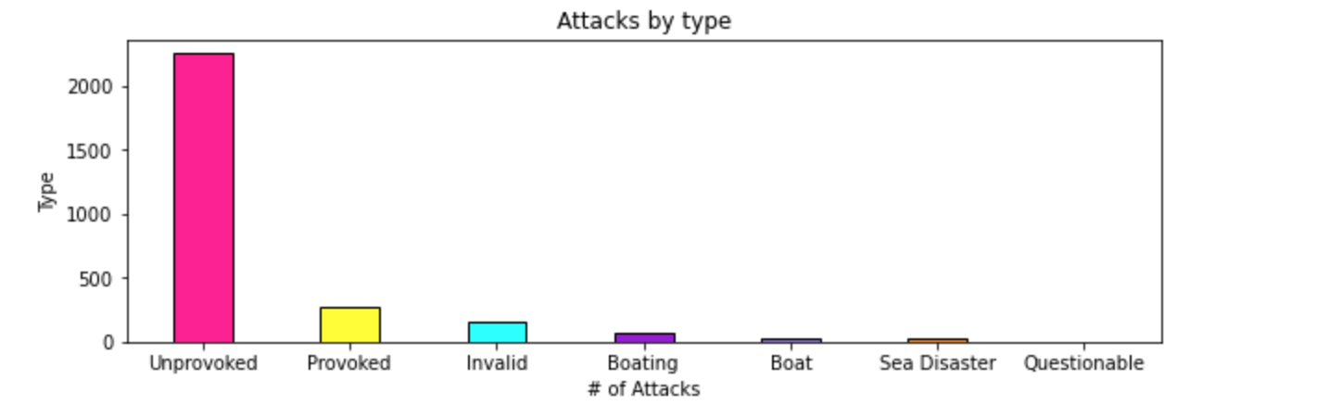
Graphics

Slide 7
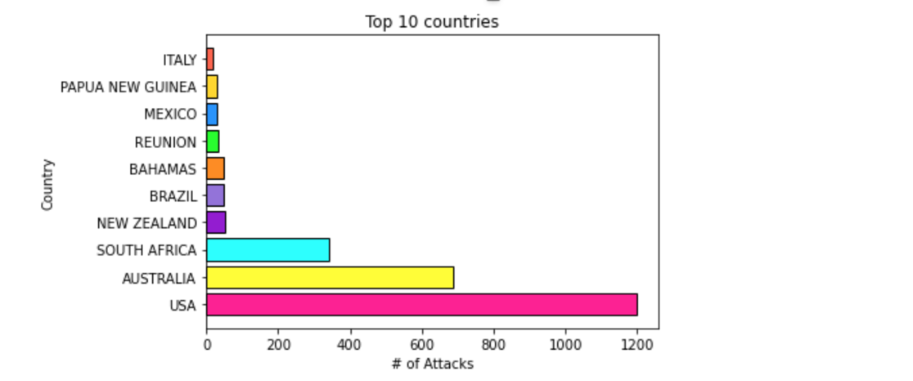
Graphics

Slide 8
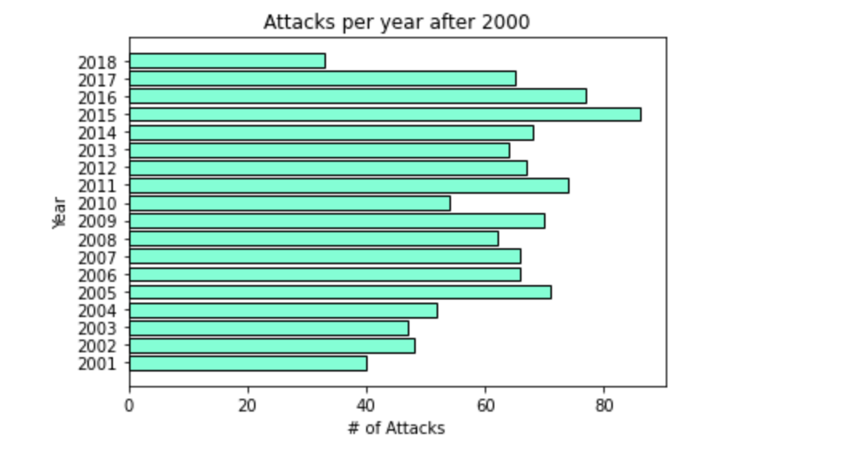
Graphics

Slide 9
Conclusions
The number of attacks were mainly unprovoked(2247), so in general all shark species attack even when people is just relaxing in the water.The next that follows unprovoked is provoked(277), so, there is certain blaime on people who disturb sharks but again is not the main reason why sharks attack. The follow invalid(163),the following is boating(65),boat(29),sea disaster(26) and last questionable(1).
The top ten countries with more shark attacks are USA 'AUSTRALIA', 'SOUTH AFRICA', 'NEW ZEALAND', 'BRAZIL', 'BAHAMAS','REUNION', 'MEXICO', 'PAPUA NEW GUINEA', 'ITALY'. It can be related with water temperature not because there’s a relationship between sharks and sharks attacks but because bathers increases which increases the risk.
Finally, analyzing the numbers of attacks from 2000 to 2018 there was a big fluctuation among years but since the
lastest peaks that were in 2015 the following years started to decrease maybe now people is more aware of this attacks
or there are more stricted rules on this issue.

